Slide 1
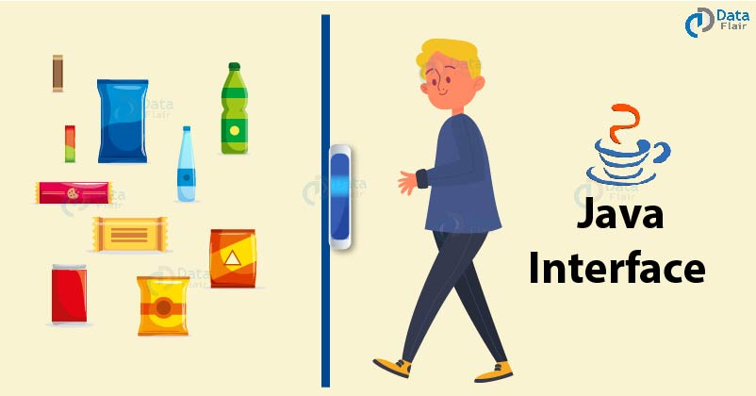
Interface in Java

Slide 2
What is Interfaces?
An interface is a reference type in Java. It is similar to class. It is a collection of abstract methods. A class implements an interface, thereby inheriting the abstract methods of the interface.

Slide 3
What is the use of the Interface in Java?
As mentioned above is used for full abstraction. Therefore, the methods in interfaces do not contain the body, they have to be implemented by the class itself before accessing them.
The class which is implementing interface must implement all the methods of the interface. Java doesn’t allow you to extend multiple classes, but you can implement more than one interface in your class.

Slide 4
Advantages of Interface in Java
For achieving total abstraction.
Multiple inheritances in Java can be achieved.
Loose coupling is done using interfaces.

Slide 5
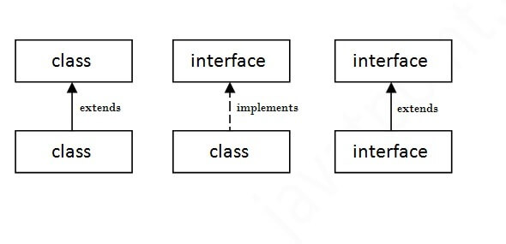
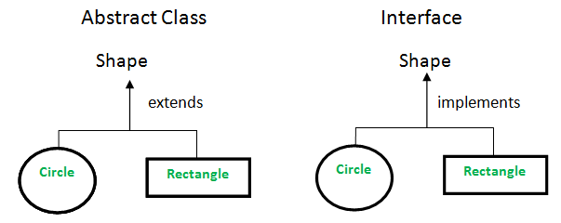
Real life example ?

Slide 6
Declaring Interfaces
import java.lang.*;
public interface NameOfInterface {
}

Slide 7
Implementing Interfaces
public class MammalInt implements Animal {
public void eat() {
System.out.println("Mammal eats");
}
public void travel() {
System.out.println("Mammal travels");
} public int noOfLegs() {
return 0;
}

Slide 8
public static void main(String args[]) {
MammalInt m = new MammalInt();
m.eat();
m.travel();
}
}

Slide 9


